Slide 1
Representations for Classical Planning

Slide 2
Quick Review of Classical Planning
s₁
s₀
Classical planning
requires all eight of the
restrictive assumptions:
  A0: Finite
  A1: Fully observable
  A2: Deterministic
  A3: Static
  A4: Attainment goals
  A5: Sequential plans
  A6: Implicit time
  A7: Offline planning
put
take
location 1
location 2
location 1
location 2
move2
move1
move2
move1
s₃
s₂
put
take
location 1
location 2
location 1
location 2
unload
load
s₄
s₅
move2
move1
location 1
location 2
location 1
location 2

Slide 3
Representations: Motivation
In most problems, far too many states to try to represent all of them explicitly as s₀, s₁, s₂, …
Represent each state as a set of features
  e.g.,
    a vector of values for a set of variables
    a set of ground atoms in some first-order language L
Define a set of operators that can be used to compute state-transitions
Don’t give all of the states explicitly
  Just give the initial state
  Use the operators to generate the other states as needed

Slide 4
Classical Representation
Atom: predicate symbol and args
  Use these to represent both fixed and dynamic relations
    adjacent(l,l’) attached(p,l) belong(k,l)
    occupied(l) at(r,l)
    loaded(r,c) unloaded(r)
    holding(k,c) empty(k)
    in(c,p) on(c,c’)
    top(c,p) top(pallet,p)
Ground expression: contains no variable symbols - e.g., in(c1,p3)
Unground expression: at least one variable symbol - e.g., in(c1,x)
Substitution: θ = {x₁ ← v₁, x₂ ← v₂, …, x_{n} ← v_{n}}
  Each x_{i} is a variable symbol; each v_{i} is a term
Instance of e: result of applying a substitution θ to e
  Replace variables of e simultaneously, not sequentially

Slide 5
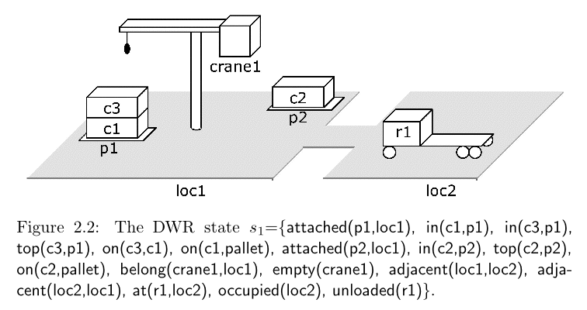
States
State: a set s of ground atoms
  The atoms represent the things that are true in one of Σ’s states
  Only finitely many ground atoms, so only finitely many possible states

Slide 6
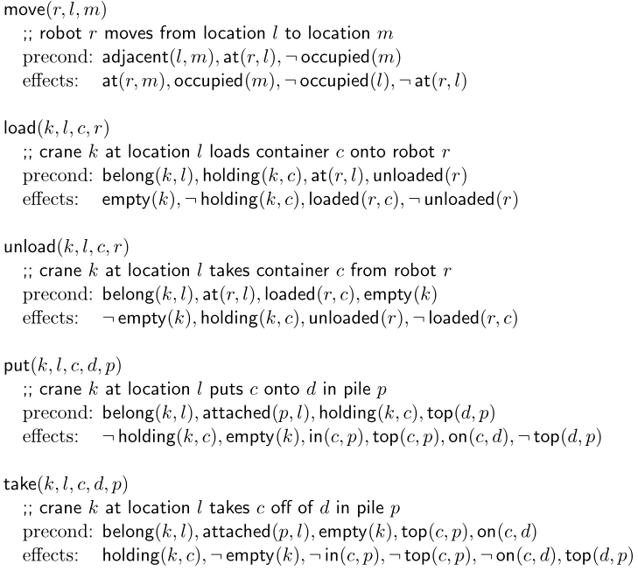
Operators
Operator: a triple o=(name(o), precond(o), effects(o))
  precond(o): preconditions
    literals that must be true in order to use the operator
  effects(o): effects
    literals the operator will make true
  name(o): a syntactic expression of the form n(x₁,…,x_{k})
    n is an operator symbol - must be unique for each operator
    (x₁,…,x_{k}) is a list of every variable symbol (parameter) that appears in o
Purpose of name(o) is so we can refer unambiguously to instances of o
Rather than writing each operator as a triple, we’ll usually write it in the following format:

Slide 7
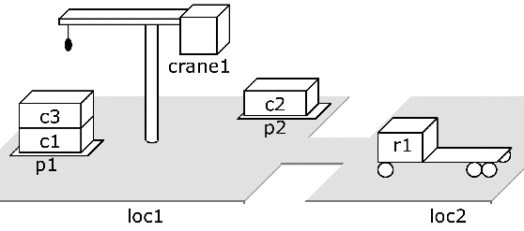
Planning domain: language plus operators
  Corresponds to a
  set of state-transition systems
  Example:
  operators for the DWR domain

Slide 8
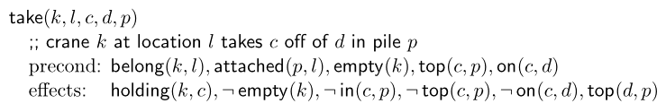
Actions
take(crane1,loc1,c3,c1,p1)
precond: belong(crane,loc1), attached(p1,loc1),
empty(crane1), top(c3,p1), on(c3,c1)
effects: holding(crane1,c3), ¬empty(crane1),
¬in(c3,p1), ¬top(c3,p1), ¬on(c1,c1), top(c1,p1)
An action is a ground instance (via substitution) of an operator
Note that an action’s name identifies it unambiguously
  take(crane1,loc1,c3,c1,p1)

Slide 9
Notation
Let S be a set of literals. Then
  S⁺ = {atoms that appear positively in S}
  S– = {atoms that appear negatively in S}
Let a be an operator or action. Then
  precond⁺(a) = {atoms that appear positively in a’s preconditions}
  precond–(a) = {atoms that appear negatively in a’s preconditions}
  effects⁺(a) = {atoms that appear positively in a’s effects}
  effects–(a) = {atoms that appear negatively in a’s effects}
  effects⁺(take(k,l,c,d,p)) = {holding(k,c), top(d,p)}
  effects–(take(k,l,c,d,p)) = {empty(k), in(c,p), top(c,p), on(c,d)}

Slide 10
Applicability
An action a is applicable to a state s if s satisfies precond(a),
  i.e., if precond⁺(a) ⊆ s and precond–(a) ∩ s = ∅
An action:
  take(crane1,loc1,c3,c1,p1)
  precond: belong(crane,loc1), attached(p1,loc1),
  empty(crane1), top(c3,p1),
  on(c3,c1)
  effects: holding(crane1,c3), ¬empty(crane1),
  ¬in(c3,p1), ¬top(c3,p1), ¬on(c1,c1), top(c1,p1)
A state it’s applicable to
  s₁ = {attached(p1,loc1), in(c1,p1), in(c3,p1), top(c3,p1), on(c3,c1), on(c1,pallet), attached(p2,loc1), in(c2,p2), top(c2,p2), on(c2,palet), belong(crane1,loc1), empty(crane1), adjacent(loc1,loc2), adjacent(loc2,loc1), at(r1,loc2), occupied(loc2, unloaded(r1)}

Slide 11
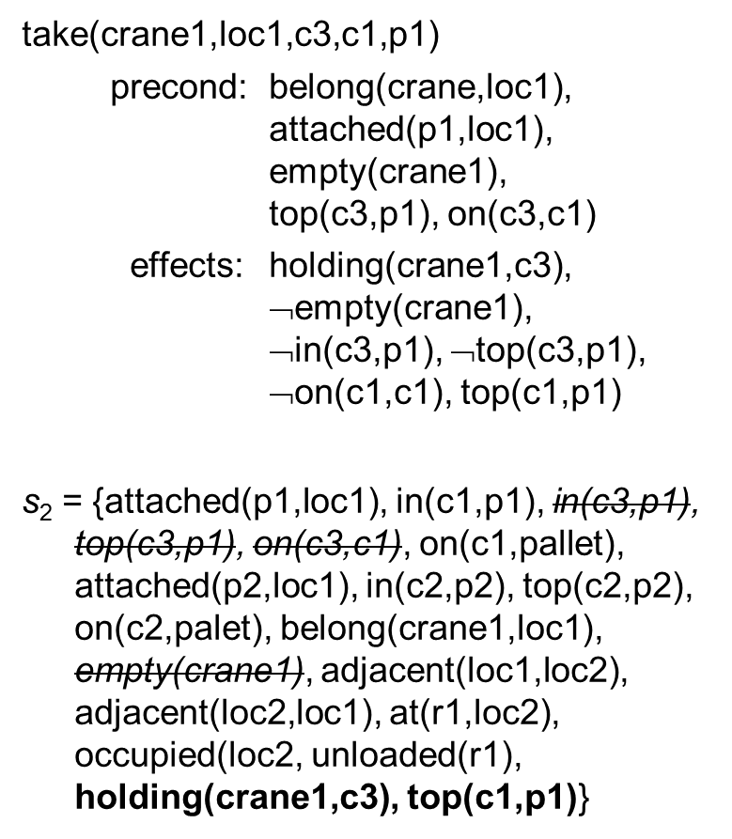
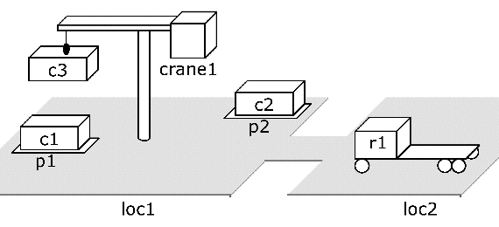
Executing an Applicable Action
Remove a’s negative effects,
and add a’s positive effects
γ(s,a) = (s – effects–(a)) ∪ effects⁺(a)

Slide 12
Planning Problems
Given a planning domain (language L, operators O)
  Statement of a planning problem: a triple P=(O,s₀,g)
    O is the collection of operators
    s₀ is a state (the initial state)
    g is a set of literals (the goal formula)
  Planning problem: P = (Σ,s₀,S_{g})
    s₀ = initial state
    S_{g} = set of goal states
    Σ = (S,A,γ) is a state-transition system
    S = {all sets of ground atoms in L}
    A = {all ground instances of operators in O}
    γ = the state-transition function determined by the operators
I’ll often say “planning problem” when I mean the statement of the problem

